Slide 1

8086 Inputs
5 V
VCC
MN/MX TEST HLDA
INTR INTA
NC
X 1
X 2
RDY1 RDY2
15 MHz
RESET
RESET
CLK READY
8086
8284 ^{CLK}
READY
5 V
F/C
CYNC AEN 1
AEN 2
NMI HOLD GND

Slide 2
^{A}16^{-A}19 BHE’
System Bus of 8086 (Address)
^{A}16^{-A}19 S₆-S₃
LS373
BHE’/S
7
G OE’
ALE
8086
AD₈-AD₁₅
LS373 G OE’
A₈-A₁₅
LS373 G OE’
AD₀-AD₇
A₀-A₇
5V
MN/MX’

Slide 3
MEMR
MEMW
SYSTEM BUS OF 8086 (DATA + CONTROL)
LOGIC CIRCUIT
RD
WR
LS244
IOR IOW
IO/M
OE’
8086
AD₈-AD₁₅
DT/R’ DEN’
LS245
DIR OE’
D₈-D₁₅
AD₀-AD₇
LS245
D₀-D₇
DIR
OE’
MN/MX’
5V

Slide 4
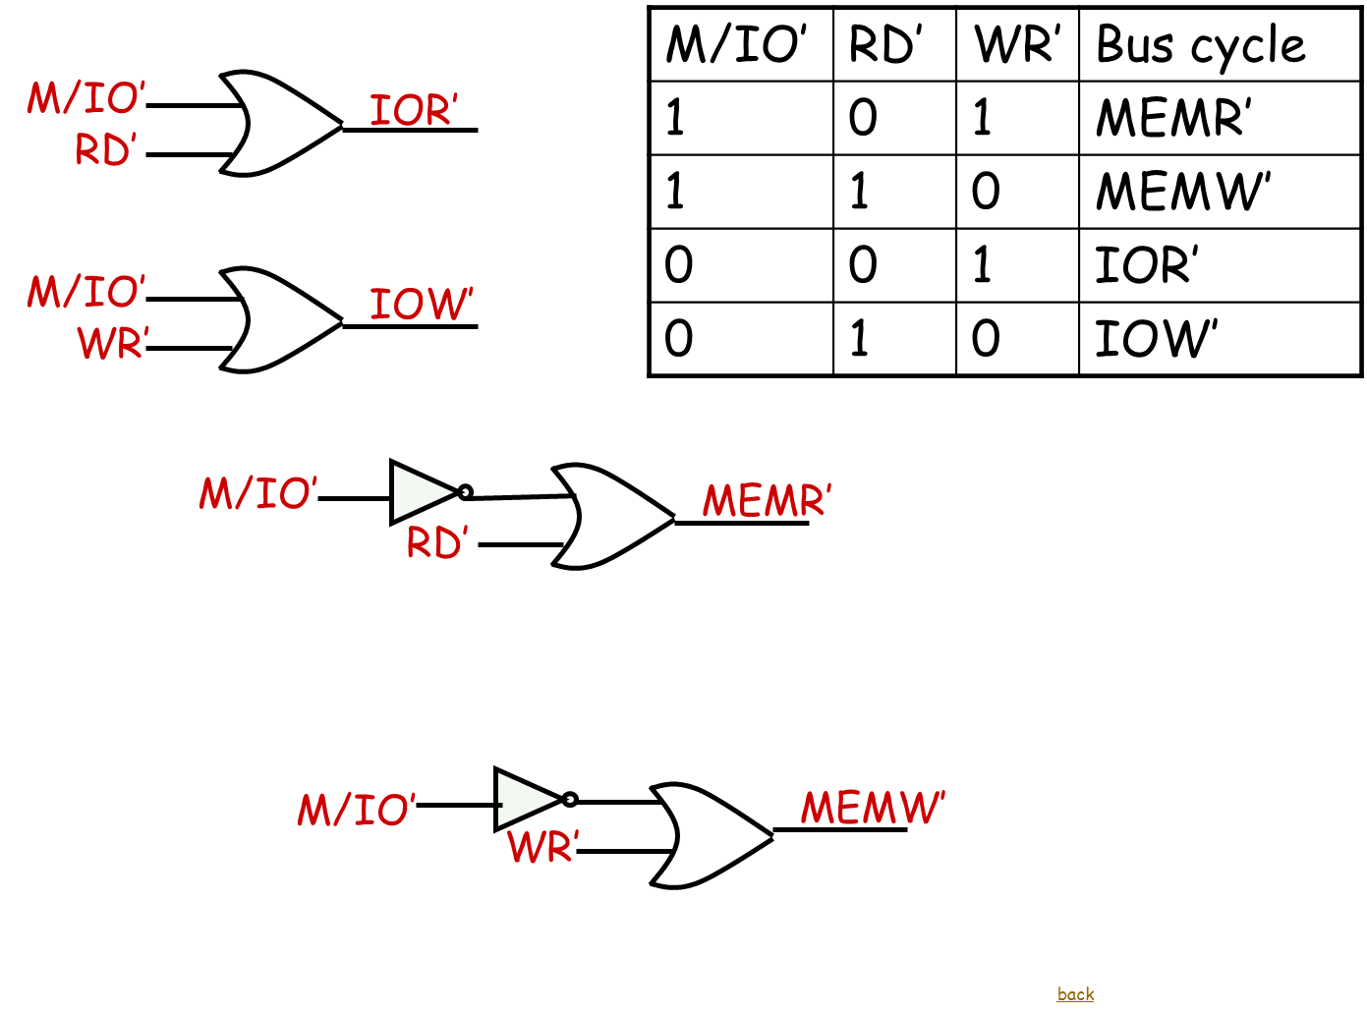

Slide 5
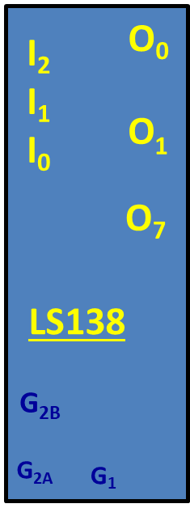
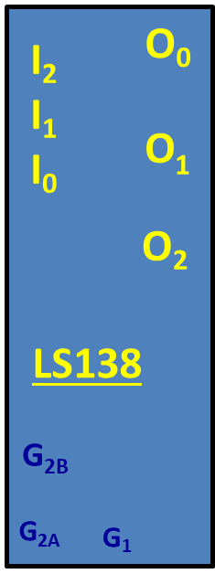
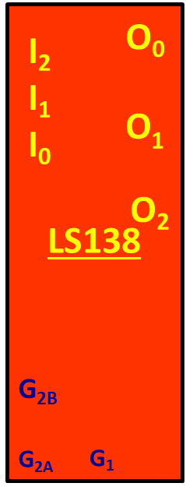
ROM₁
Memory Decoder
O₀
A14
I₂
I₁ I₀
A₀ RAM MEMR’
RDL’
A13
O
A12
1
ROM₂
A₀ MEMW’
LS138
WRL’
GND
^{G}2B
BHE’ MEMW’
WRH’
2
^{G}2A
G₁
^{V}CC
RDH’
GND
BHE’ MEMR’

Slide 6
Memory Interfacing
A₁ ^{A}11
A₀ ^{A}10
D₀ D₇
D₀ D₇
A₁ ^{A}11
A₀ ^{A}10
D₀ D₇
D₀ D₇
A₁ ^{A}11
A₀ ^{A}10
D₀ D₇
D₀ D₇
2716_{1E}
OE’
CS’
2716_{2E}
OE’
CS’
6116_{1E}
WE’
OE’
CS’
WRL’ RDL’ RAM’
RDL’ ROM’₁
RDL’ ROM’₂
A₁ ^{A}11
A₀ ^{A}10
D₀ D₇
D₈ ^{D}15
A₁ ^{A}11
A₀ ^{A}10
D₀ D₇
D₈ ^{D}15
A₁ ^{A}11
A₀ ^{A}10
D₀ D₇
D₈ ^{D}15
2716_{1O}
OE’
CS’
2716_{2O}
OE’
CS’
6116_{1O}
WE’
OE’
CS’
WRH’ RDH’ ROM’₁
RDH’ ROM’₁
RDH’ ROM’₂

Slide 7
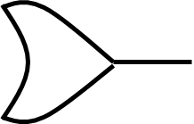
8255 CS’
I/O Decoder
A₇ A₇ A₃
I₂ I₁ I₀
O₀
O
8254 CS’
1
O₂
LS138
A7
E2
_{E2}
A6
^{G}2B
^{G}2A
G₁
A5
E3
A0
_{E3}
^{A4}

Slide 8
INVALID LED
LED DECODER
PB₀ PB₁
I₂ I₁ I₀
O₀
O
PERK LED
1
O₂
_{O3}
DAIRY MILK LED
FIVE STAR LED
LS138
_{EN’LED}
^{G}2B
^{G}2A
G₁
_{ENLED}
_{EN’LED}
_{EN’LED}
_{ENLED}
ENLED IS FROM 8255

Slide 9
8255 Interface to the processor
A₁ A₂
8255 CS’
A₀ A₁
CS
8255
RD
RD
WR
WR
D₀ – D₇
D₀ – D₇
RESET
from 8284
RESET

Slide 10
ADC 0808
CLOCK_ADC
CLK
DB₀ – DB₇
AD_{A} AD_{B} AD_{C}
EOC
IN₀ IN₁ IN₂ IN₃ IN₄ IN₅ IN₆ IN₇
INPUT0
PA₀ –PA₇
EOC
AND
PB₂ PB₁ PB₀
EOC
Vcc
^{V}RE+ ^{V}REF-
Vcc
GND
5V
0V
Supply
M1
M1
OE
SOC
START
5V
ALE
ADC 0808

Slide 11
MPX 4250 – Pressure Sensor
3.0
1 2 3 4 5 6
INPUT0
VsPressureSensor

Slide 12
8254 Interface to the processor
A₁ A₂
8254 CS’
A₀ A₁
CS
8254
RD
RD
WR
WR
D₀ – D₇
D₀ – D₇

Slide 13
UNIPOLAR STEPPER MOTOR
PB2
PB3
+88.8
PB5
PB4

